Slide 1
PDE 3802 Artificial Intelligence in Robotics Week 1: Introduction
Department of Design Engineering and Mathematics

Slide 2
Part 1
Module Organisation

Slide 3
Overview of the lecture:
Part 1 – Module Organisation
Learning Outcomes
Lecture planner
Coursework
Part 2 – Introduction to Sensing in Robotics
History of Robotics
Definition of Robots
Autonomous Robots
Robots Architecture
Sensing and Robotics

Slide 4
Learning Outcomes
Module aim:
This module aims to provide students with knowledge and practical skills of Artificial Intelligence (AI) and Machine Learning (ML) techniques used in robotics. The module will cover different types of autonomous robots in a variety of fields and applications.
Students will acquire knowledge and practical skills on robot sensory processing, particularly vision, and on the use of machine learning methods and algorithms, and how these are applied to real life autonomous robotic applications.

Slide 5
Learning Outcomes
Module- Knowledge
LO1 | Demonstrate technical knowledge of AI/ML techniques used in robotics.
LO2 | Critically analyse robotics problems to determine the most suitable hardware and software solutions for autonomous robot applications.
LO3 | Demonstrate in-depth knowledge of robotic sensing (particularly vision).
Module- Skills
LO4 | Design and implement AI/ML solutions to robotics problems, using appropriate tools and relevant sources.
LO5 | Develop software modules for implementing advanced robotic capabilities, such as vision-based manipulation or human robot interaction.

Slide 6
Module Structure
Module code: PDE3802
Module title: Artificial Intelligence in Robotics
Structure: 6hrs workshop per week
Duration: 12 Weeks
Venue: H101
Module weight: 30 Credits
Learning scheme (30 credits x 10 hrs):
Independent study: 228hrs
Scheduled teaching: 72hrs
Assessments: 2 Coursework (Wk 6 & Wk 12)

Slide 7
Learning Materials
Books:
Computer Vision Algorithms and Applications - R. Szeliski, Springer, 2011.
Technologies for smart sensors and sensor fusion. Yallup, Kevin, and Krzysztof Iniewski, eds. CRC Press, 2014.
https://mdx.keylinks.org/new-ui/hierarchy/list/24270
Lectures slides
Recommended Videos
Recommended research papers/journals (IEEE, ACM, Science Direct, Springer etc)

Slide 8

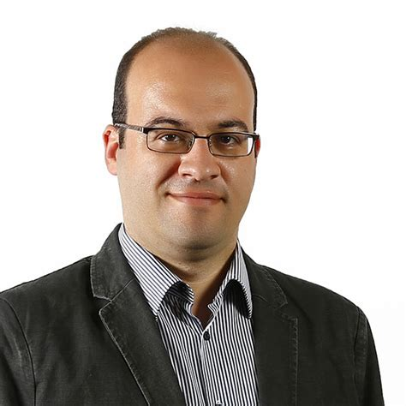
Communication channel
In Person: During/after any weekly session
Using email:
Specify module code PDE3802 along with issue in the subject of the email
Expect at most 2-3 working days for a reply
E-mail: t.girici@mdx.ac.uk
Module Leader: Purav Shah
 | Room number: | T115
 | Email: | p.shah@mdx.ac.uk
 | Telephone number: | 02084115317
 | Office hours: | Thursdays 14:30-16:30
Module Tutor: Tolga Girici (CONTACT)
 | Room number: | HPA Office
 | Email: | T.Girici@mdx.ac.uk
 | Telephone number:
 | Office hours:

Slide 9
Resources & development tools
Your laptop computer
RGB camera
Microphone
Programming Languages: Python
Anaconda
Jupyter Notebook
VSCode or Pycharm or similar
Linux
ROS-2
Gazebo

Slide 10
Assessment 1:
Coursework 1 – 60%
Students will be given a task requiring advanced sensory processing and actuation,
they will study the problem and design a solution based on appropriate research.
They will write a technical report explaining their solution
Students will solve an image recognition/classification task
They will provide the programming code
They will prepare a 3 minute demonstration video
Task: Autonomous system design report and Computer vision task (Due: Mid-semester)
Weighting | Specification e.g. word count / duration / no. of pages | LO mapped to | Anonymously marked | Ethics approval required
60% | Report (max 3000 words) Code and demo video (max 3 minutes) | 1,2,3,4 | ☒ No ☐ Yes | ☒ No ☐ Yes – individual student ☐ Yes – group approval ☐ Yes – whole module

Slide 11
Assessment 1 – Part A (30%)
Write a <3000 word report (11pt MS word format) that designs an autonomous robotic system for finding and organizing office items (e.g., chair, bin, mug, bottle, book, keyboard, mouse, stapler, notebook, phone) in a typical indoor office.
Assume the activity is not time-critical (no strict time limit per action once a turn/command is established).
Your report must specify:
1) Mission & Tasks: A concise description of what the robot must accomplish and a task list (e.g., patrol → detect target category → decide action → navigate to item → report/organize).
2) Required Skills (with interfaces): What the robot needs to be able to do (perception, localization, planning, optional manipulation/HRI). For each skill, describe inputs/outputs and success criteria.
3) Hardware Components (with alternatives): Sensors (RGB camera, depth camera/OAK-D, 2D LiDAR, IMU, AprilTags) and actuators/computing (Raspberry Pi/NUC). Provide alternatives for each component and justify choices (accuracy, cost, compute, integration complexity).
4) Software Architecture: A block diagram showing the main modules (e.g., detection, depth-to-3D, mapping, navigation), data flows, and (if known) ROS 2 topics/actions/frames you’d use in the second half of the module.
5) Dataset & Model Plan: What classes you will recognize, how you will collect/label data, how you will evaluate (accuracy, F1, confusion matrix, or mAP if you consider detection later).
6) Risk & Safety: E-stop, speed caps, minimum obstacle distance, fallback when detection/localization fails.
7) Budget / BOM: A realistic bill of materials with indicative prices and a target budget
8) References & Contributions: Cite relevant sources; include a short contributions section for each group member (if it is a team work).

Slide 12
Assessment 1 – Part B (30%)
Office-Goods Classification Code (30%):
Task: Write software that recognizes an office item class from a single image or live camera frame (one item at a time).
The program must accept input from file(s) or from a standard camera and output the predicted class (and confidence, if available).
You may implement specific computer-vision logic or use machine learning/deep learning. You may use OpenCV and common Python libraries (NumPy, scikit-learn, PyTorch/TensorFlow, or YOLO-cls).
Sometimes implementing a small function yourself is faster than integrating a heavy external dependency—use good judgement.
Use 6–10 classes relevant to the “office organizer” theme.
Aim for sufficient number of images per class where possible.
Provide all images used for training/validation/testing (a download link if size is large). Include a dataset card.
Present a README file that explains how to install, how to run (examples), expected outputs, and troubleshooting.
Use Git (GitLab/GitHub). Commit regularly and using meaningful messages. Tag the release you submit.
Report accuracy and macro-F1 on a held-out test set, plus a confusion matrix. Include a brief error analysis

Slide 13
Assessment 2:
Coursework 2 – 40%
Students will design and implement a sensory solution for a real robotic problem,
including all the steps from data gathering, pre-processing, analysing and visualising/ presenting results.
Students will submit code, with informative readme file, and a short demo video of the process and results.
Task: Autonomous system design and Computer vision task (Due: Mid-semester)
Weighting | Specification e.g. word count / duration / no. of pages | LO mapped to | Anonymously marked | Ethics approval required
40% | Code and a 10 minute presentation | 1,2,4,5 | ☒ No ☐ Yes | ☒ No ☐ Yes – individual student ☐ Yes – group approval ☐ Yes – whole module

Slide 14
Assessment 2 – (40%)
Perform real-time (or near-real-time) classification
of 6–10 office classes (e.g., chair, bin, mug, bottle, book, keyboard, mouse, stapler, notebook, phone)
from the Pi camera feed using Raspberry Pi.
All inference runs on the Pi (no cloud).
Training may be done on the Pi or off-device (laptop/workstation) and then deployed.
Target functional requirement are
1) Live classification with >5 FPS on RPi4 at 224-320 pixels of input,
2) Two modes of operation such as Live camera view and evaluation of a file input.
3) Distance and pose estimation.
You may reuse and/or fine-tune the model you trained in Assessment 1, or train a fresh model.
You have to deliver
a presentation,
make a demonstration
and also deliver your code repository with a clear README file with install instructions, launch commands, parameter table, and troubleshooting.

Slide 15
Academic Integrity and misconduct
Plagiarism
Using extensive unacknowledged quotations from, or direct copying of, another person’s work and presenting it for assessment as if it were your own effort. This includes the use of third-party essay writing services.
Collusion
working together with other students (without the tutor’s permission), and presenting similar or identical work for assessment.
Self-Plagiarism
including any material which is identical or substantially similar to material that has already been submitted by you for another assessment in the University or elsewhere.

Slide 16
Lecture overview:
Week Beginning | Week | Lecture | Workshop | Assessment and Feedback
22nd Sept | 1 | Introduction, Autonomous Robots and Robotic systems architecture | Anaconda installation, Python, Linux , Gitlab | Assessment 1 (A1) brief
29th Sept | 2 | Natural Vision, Artificial Vision | CV warm-up: OpenCV I/O, color spaces, resizing, basic filters | A1 discussion
6th Oct | 3 | OpenCV: edges, morphology, histograms; camera models, calibration theory. | Lab on image processing using cv2 library, Cam. Calibration | A1 outline (tasks/skills/sensors); A1 dataset plan (classes, sources)
13th Oct | 4 | ML for Vision: train/val/test, precision/recall/F1, confusion matrix; augmentation | Binary classification, Keras, MNIST, HOG+SVM | A1 classification metrics
20th Oct | 5 | CNNs: convolution, stride/padding, receptive fields; transfer learning (TL); overfitting, YOLO | TL: ResNet etc. YOLO dataset and practice | A1 Progress
27th Oct | 6 | ROS 2 Essentials: nodes/topics/services/actions; colcon; params/launch; TF intro; RViz/rosbag | Wrap-up & finalize code; README, CLI; record short demo | A1 DUE (end of week) — Submit A1 report + A1 code, 3-min concept video link.
3rd Nov | 7 | Depth & Frames: RGB-D/LiDAR basics; depth→3D projection | Pose estimation, Linux&ROS-2 practice | A2 brief
10th Nov | 8 | YOLO and ROS2, URDF, Gazebo | Run YOLO on robot/edge PC; RViz overlay; log fps/latency | A2 Progress
17th Nov | 9 | Kinematics , Odometry | Gazebo practice | A2 Progress
24th Nov | 10 | Sensor Fusion, Accelerometer, IMU | Gazebo practice
1st Dec | 11 | Work on A2 | Work on A2 | Work on A2
8th Dec | 12 | A2 presentation and demos

Slide 17
Part 2
Introduction to Robotics

Slide 18
What is a robot?
A machine - especially one programmable by a computer - capable of carrying out a complex series of actions automatically.
A programmable, multifunction manipulator designed to move material, parts, tools or specific devices through variable programmed motions for the performance of a variety of tasks.
A system which exists in the physical world and autonomously senses its environment and acts in and on it.
A machine able to extract information from its environment and use knowledge about its world to move safely in a meaningful and purposeful manner.
Robotics is the intelligent connection of perception to action.
An active artificial agent whose environment is the physical world.

Slide 19
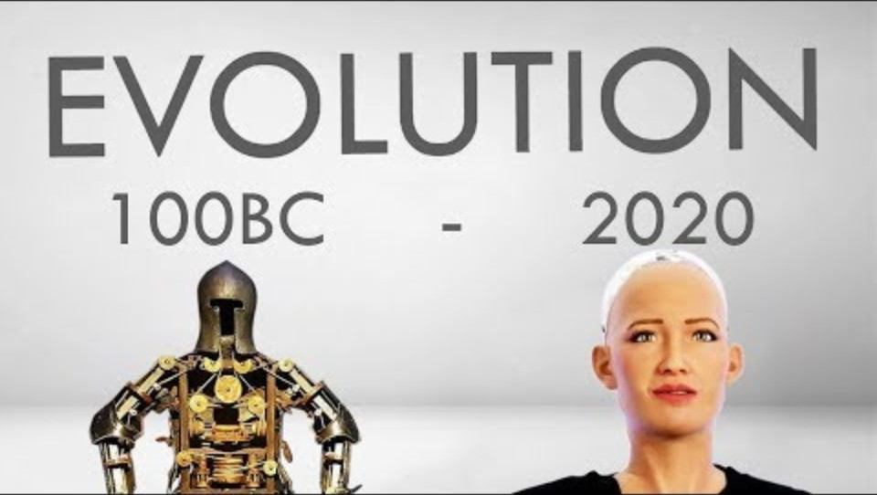
A short history of robotics

Slide 20
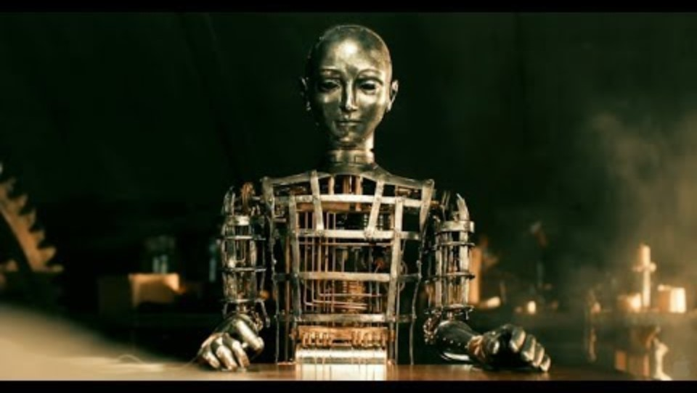
A short history of robotics

Slide 21
What shape should a robot have?
Google “robot”
What is a robot for the public and what is a robot for an engineer?
Movies: AI (2001), Ex Machina, Terminator, Transformers, Big Hero 6
Should it be human or at least animal like? Part(s) of a body? What else?
We will find the issue of anthropomorphism, or biological mimetism, in AI, too.
Notes:
the attribution of human characteristics or behaviour to a god, animal, or object.
mimicry is an evolved resemblance between an organism and another object, often an organism of another species

Slide 22
Robot examples
https://robotsguide.com/robots

Slide 23
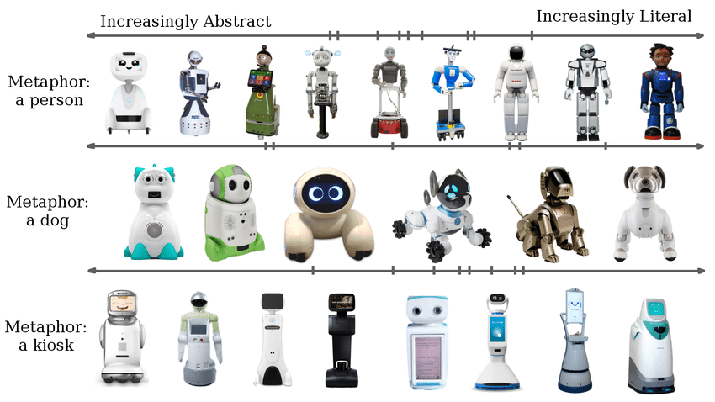
Robot examples

Slide 24
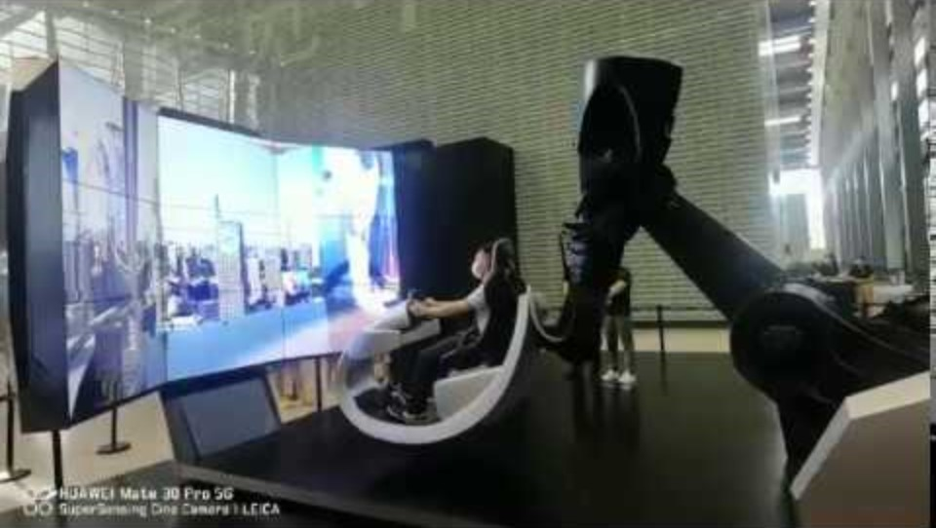
Robot examples

Slide 25
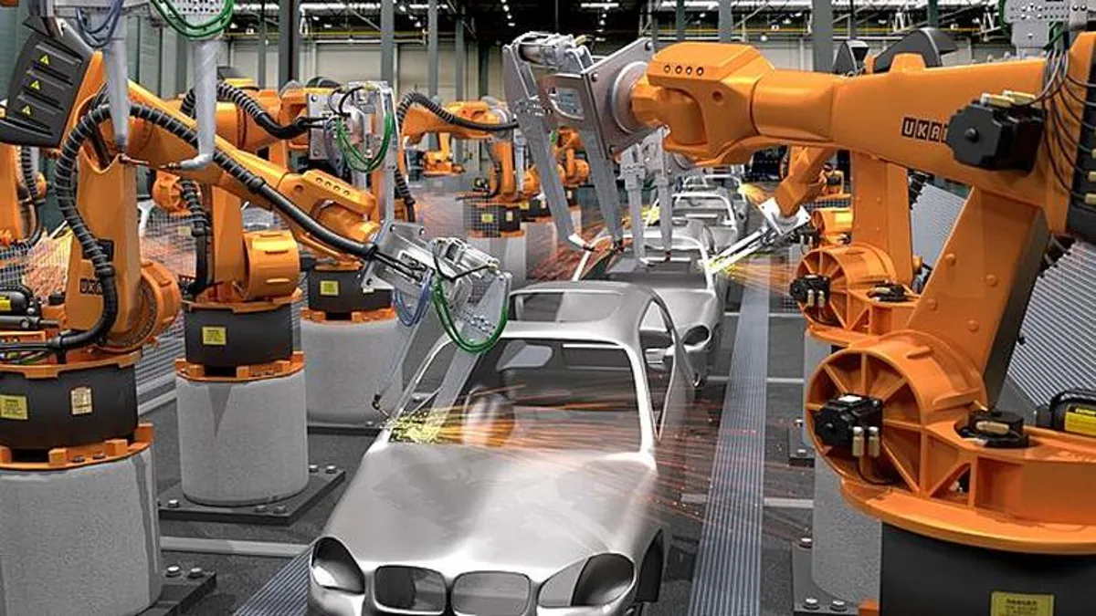
Traditional Industrial Robots
They use robot arms and largely pre-computed motions
Repetitive tasks
High speed
Few sensing operations
High precision movements
Pre-planned trajectories
No interaction with humans

Slide 26
Limitations
Traditional programming techniques for industrial robots lack key capabilities necessary in intelligent environments
Only limited on-line sensing
No incorporation of uncertainty
No interaction with humans
Reliance on perfect task information
Complete re-programming for new tasks
Introduce AI into robotics!!

Slide 27
Autonomous Robots
When is a robot autonomous?
Autonomy is the ability to sense the situation, take decisions and act on them appropriately
Autonomy can be partial, as in tele-operated robots
Are exo-skeletons autonomous robots?
Is a web algorithm (softbot) an autonomous robot?
Robots in robot wars?

Slide 28
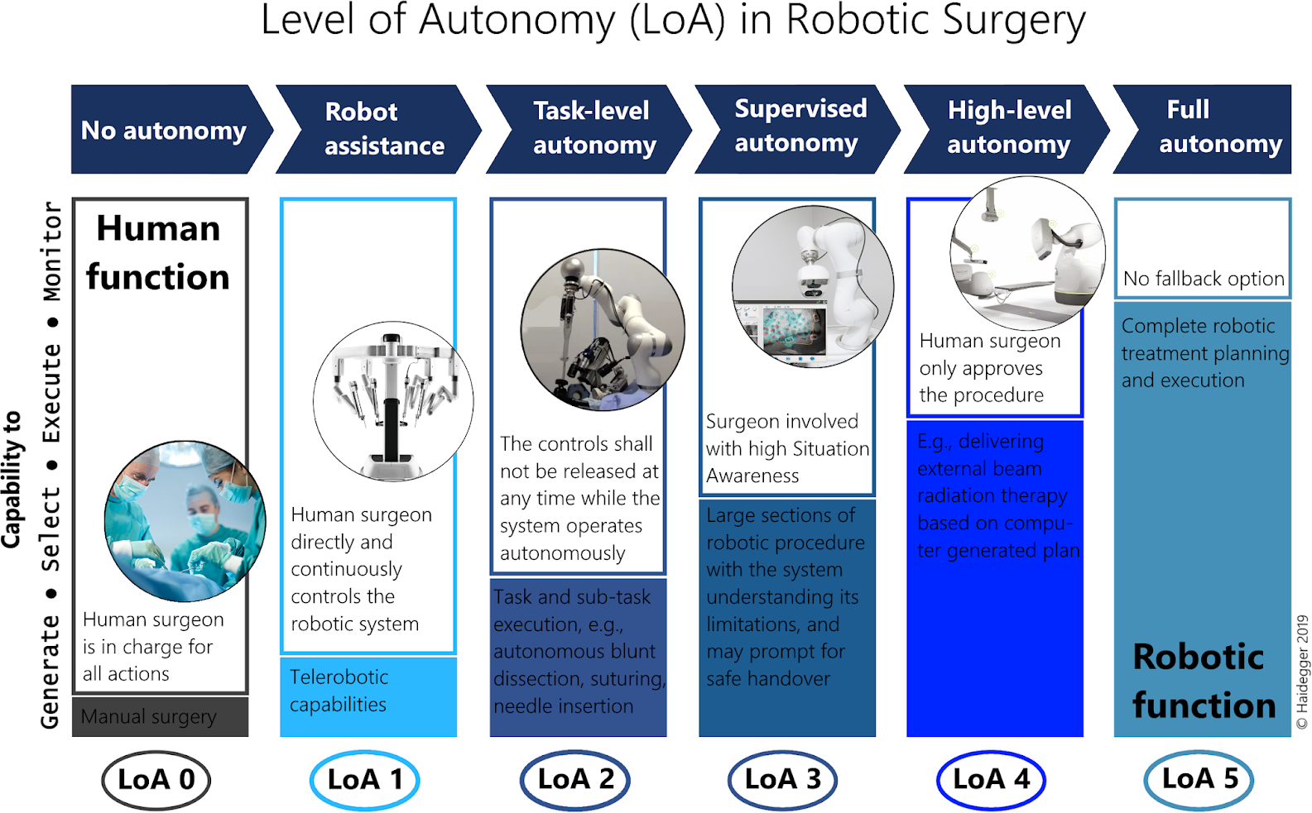
Autonomous Robots – Level of Autonomy

Slide 29
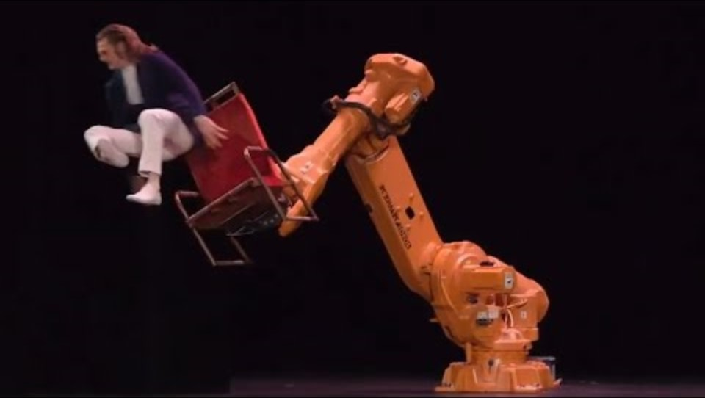
Autonomous Robots

Slide 30
What are the skills of Autonomous Robots?
Reliable control of the actuators
Closed-loop control
Generation of task-specific motions
Path planning
Integration of sensors
Selection and interfacing of various types of sensors
Coping with noise and uncertainty
Filtering of sensor noise and actuator uncertainty
Creation of flexible control policies
Control has to deal with new situations
Learning
Build upon its own experience
Emotion / motivation ?

Slide 31
Robot components
A robot perceives an environment using sensors to control its actuators.
The main parts of the robot correspond to the primitives of robotics:
Sense -> Plan -> and Act.
The primitives form a control architecture that is called robotic paradigm.

Slide 32
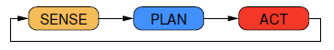
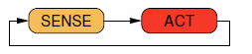
Robot Paradigms
The three main robotics paradigms proposed are as below:
Hierarchical Paradigm is a purely deliberative system. It assumes that everything is known.
Reactive Paradigm represents reactive control. Assume nothing is known, use immediate input for control in multiple tight feedback loops.
Notes:
Deliberative: carefully thought through or discussed

Slide 33
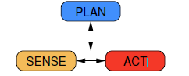
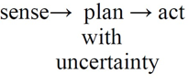
Robot Paradigms
Hybrid Paradigm combines reactive and deliberative. Plan for ideal world, react to deal with run-time error.
Probabilistic Paradigm explicitly model what is not known.

Slide 34
Robot Control
Robot control refers to the way in which the sensing and action of a robot are coordinated.
Control Approaches (robot architectures / paradigms):
Deliberative Control
Reactive Control
Behaviour-Based Control
Hybrid Control

Slide 35
The planning/control problem
Get robot from A to B, within certain time
Complete a mission within power constraints
Map an area to a given level of accuracy
Decide between alternative routes, e.g., uncertain shortcut vs. well-known path
Stay on the road and don’t collide with anything
What sensors, actuators, control strategies do we need?

Slide 36
Robot architectures
Control Approaches (= robot architectures):
Deliberative Control : Think hard, act later.
Reactive Control : Don’t think, (re)act.
Behaviour-Based Control : Think the way you act.
Hybrid Control : Think and act independently, in parallel.
This is in practice an artificially discrete subdivision, since most solutions are somehow hybrid
Knowing the possible approaches to link sensory input with motor output is nevertheless important to devise the best solutions for a problem in robotics

Slide 37
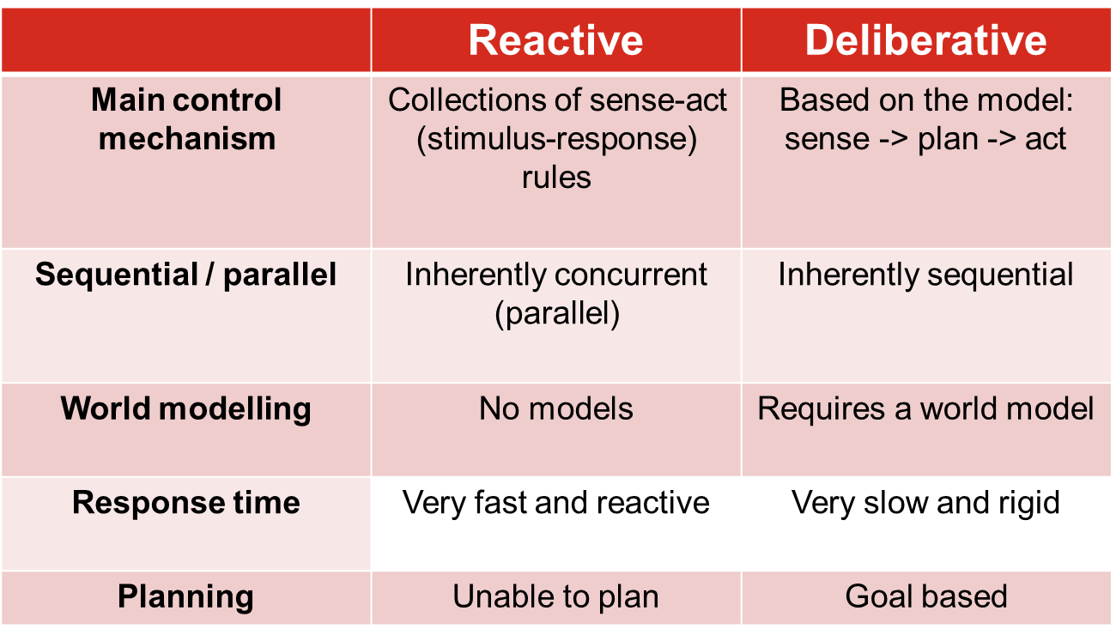
Reactive vs. Deliberative architectures

Slide 38
Robot Sensing
Sensors are devices that enable a robot to perceive its physical environment to get information about itself and its surroundings
What can be sensed?
depends on the sensors on the robot
robotic sensors are very different from biological sensors
the robot exists in its sensor space (all possible values of its sensory readings, also called perceptual space)
a roboticist needs to imagine the world in the robot’s sensor space

Slide 39
Robot Actuators/Effectors
A robot acts through the use of its actuators, also called effectors
Robotic actuators are very different from biological ones, both are used for:
locomotion (moving around, going places)
manipulation (handling objects)
Robotics was traditionally divided into three areas (not quite anymore):
mobile robotics
manipulator robotics
social robotics

Slide 40
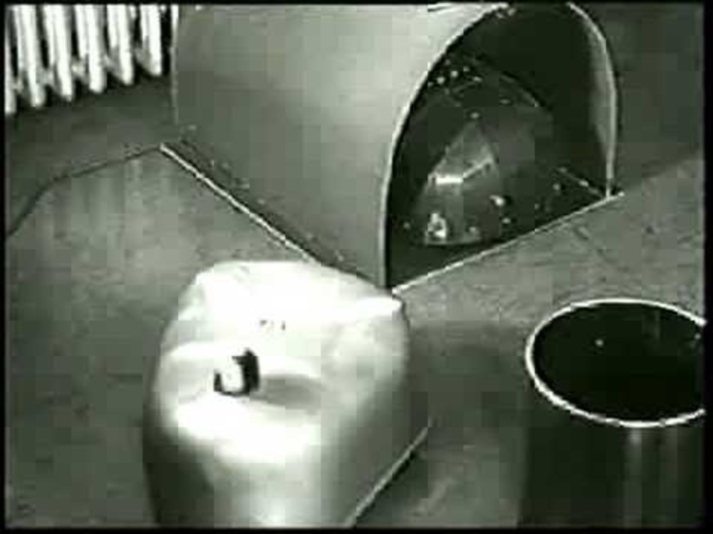
Grey Walter’s tortoise – Sensing and action
https://spectrum.ieee.org/meet-roombas-ancestor-cybernetic-tortoise

Slide 41
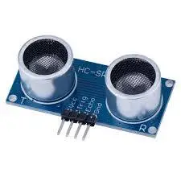
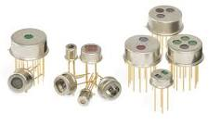
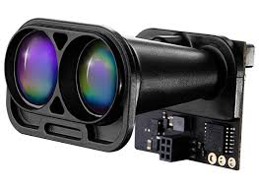
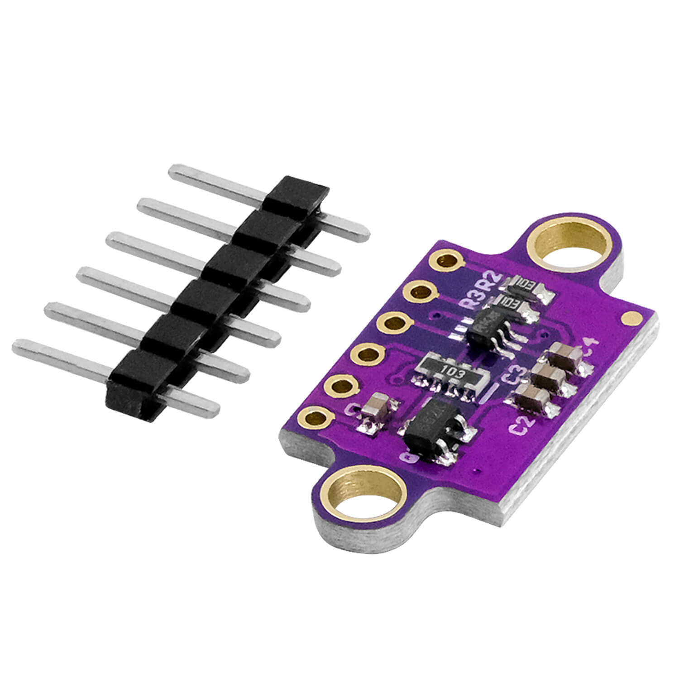
Robot Sensors
Robots rely on a variety of sensors to perceive and interact with the world. Here are some common types of sensors found in robotics:
Proximity and Distance Sensors
Ultrasonic sensors: Emit high-frequency sound waves and measure echo return time to calculate distance.
Infrared (IR) sensors: Use infrared light to detect proximity. Often used in short-range distance measurement and obstacle detection.
LIDAR (Light Detection and Ranging): Uses laser pulses to measure the distance to objects, creating a detailed 2D or 3D map of the environment.
Time-of-Flight (ToF) sensors: Similar to LIDAR but often integrated into smaller devices. They measure the time it takes for emitted light to return after reflecting off an object.

Slide 42
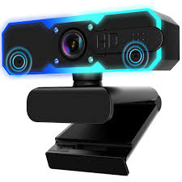
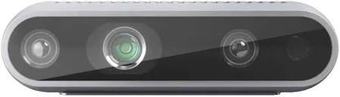
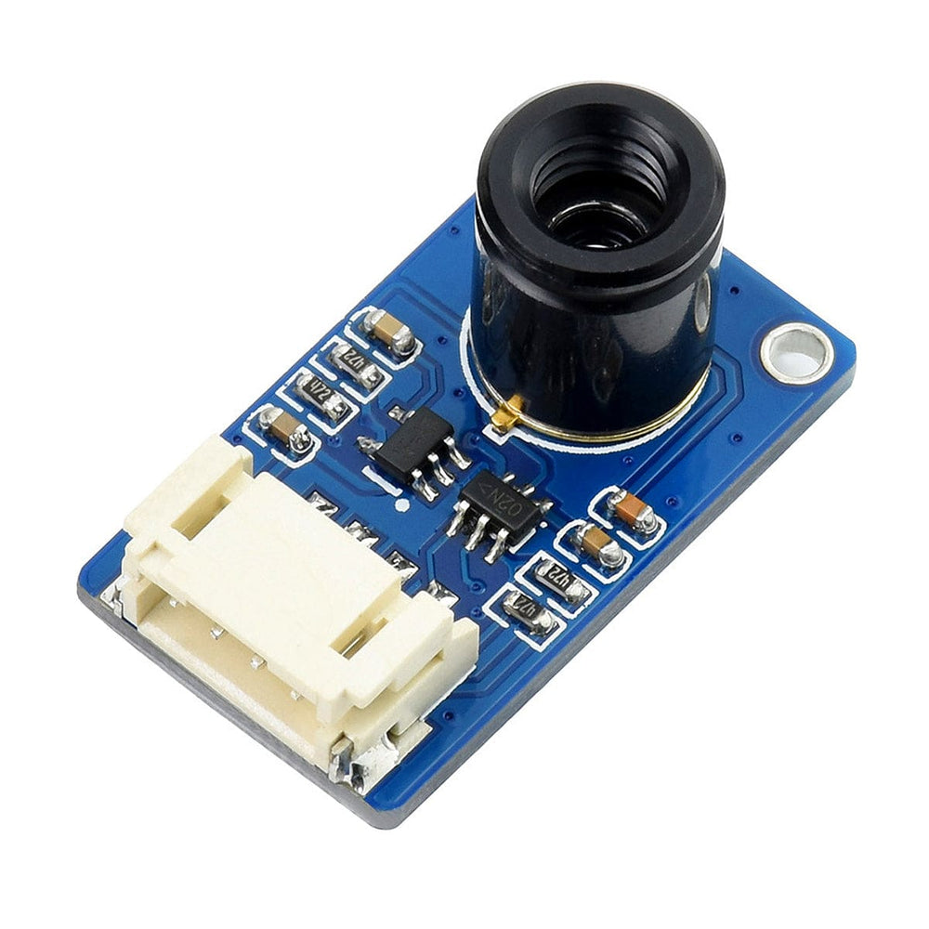
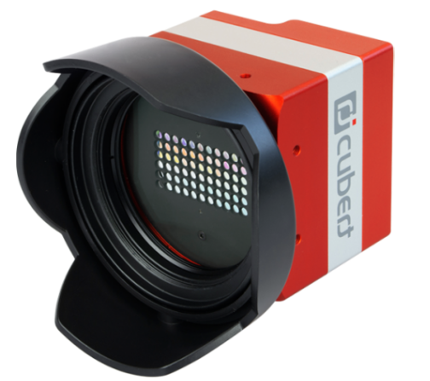
Robot Sensors
Vision and Imaging Sensors
Cameras (RGB, grayscale): Provide visual information; used for tasks like object recognition, tracking, and navigation.
Depth cameras (RGB-D): Combine a standard RGB camera with a depth sensor to capture both color and 3D shape information. Examples include stereoscopic cameras and structured light cameras (e.g., Microsoft Kinect).
Thermal cameras: Detect heat signatures, useful in night vision or hazardous environments.
Multispectral or hyperspectral cameras: Capture information at specific frequencies across the electromagnetic spectrum, often used in agricultural or inspection robotics.

Slide 43
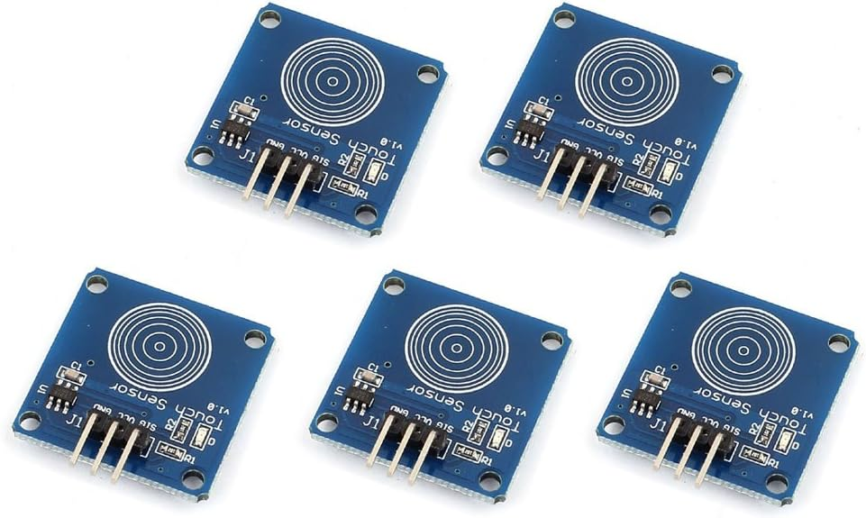
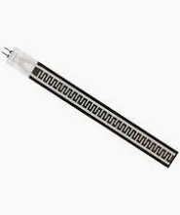
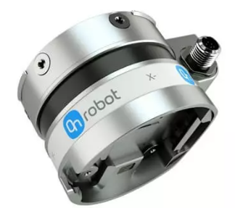
Robot Sensors
Tactile and Force Sensors
Touch sensors: Detect contact or pressure on a robot’s surface (similar to a simple switch or pressure pad).
Force/torque sensors: Measure how much force is being applied in multiple axes, critical for tasks like gripping objects with the correct pressure or collaborative robot arms that need to sense when they contact humans or obstacles.

Slide 44
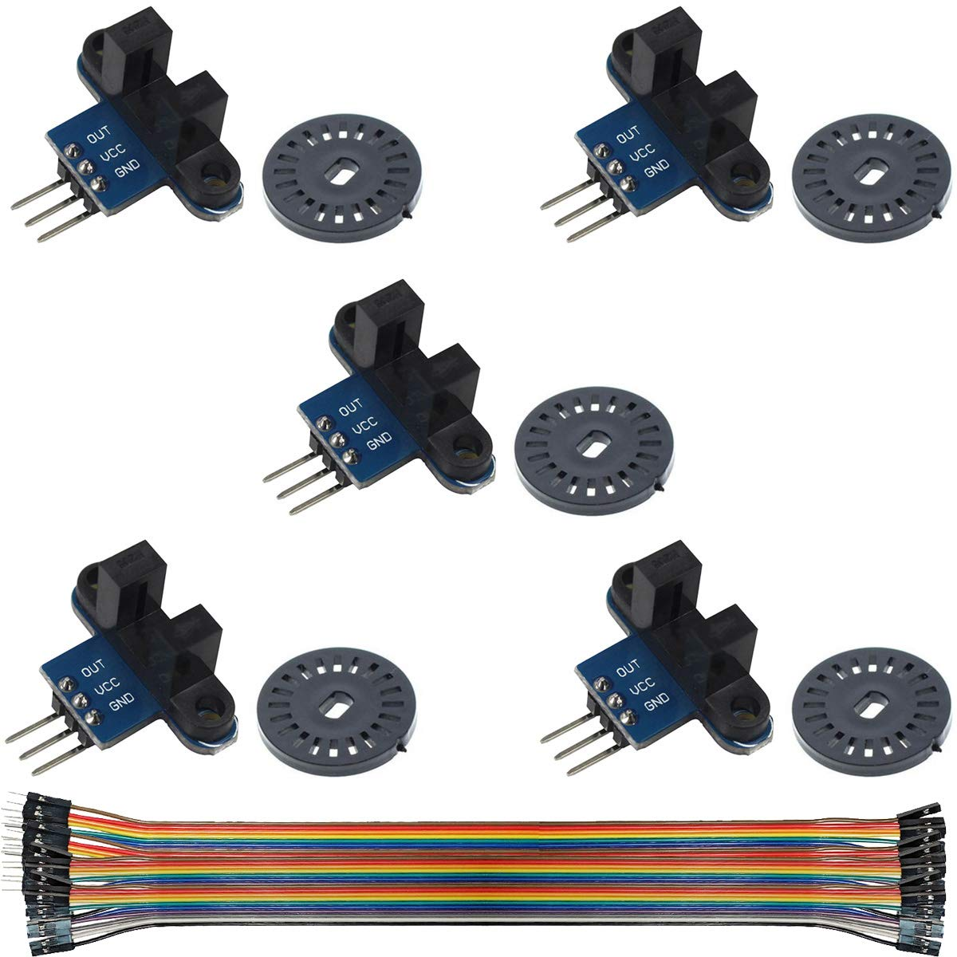
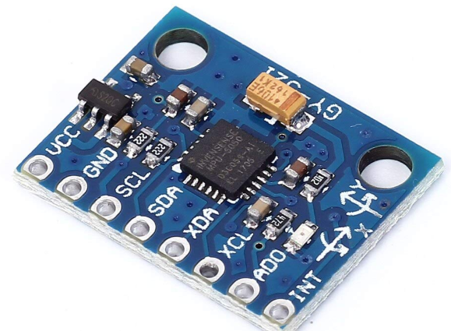
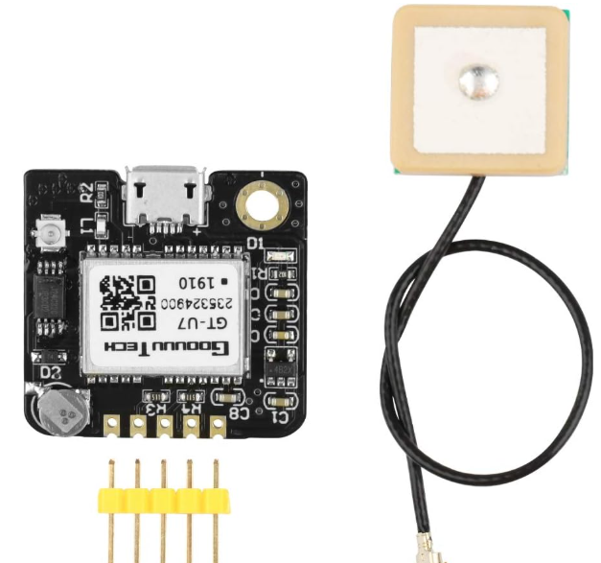
Robot Sensors
Position and Motion Sensors
Encoders: Measure rotation or linear motion of motors and shafts, providing feedback for precise control of joints and wheels.
Inertial Measurement Units (IMU): Combine accelerometers, gyroscopes, and sometimes magnetometers to track orientation, acceleration, and angular velocity.
GPS (Global Positioning System): Provides global position data, typically used for outdoor navigation (e.g., in drones or autonomous vehicles).

Slide 45
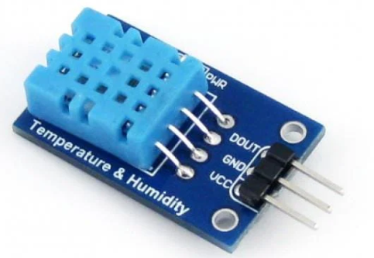
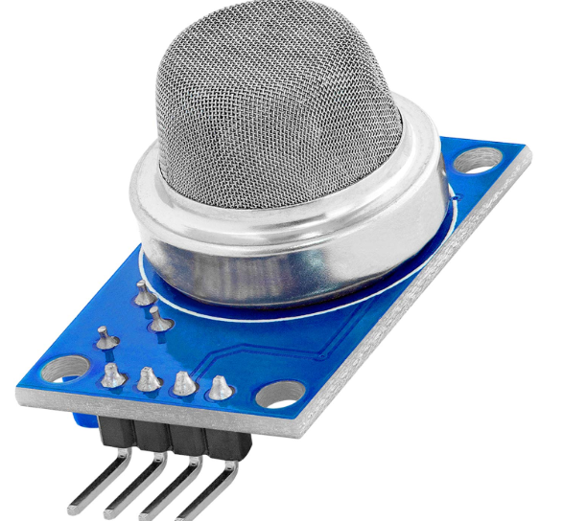
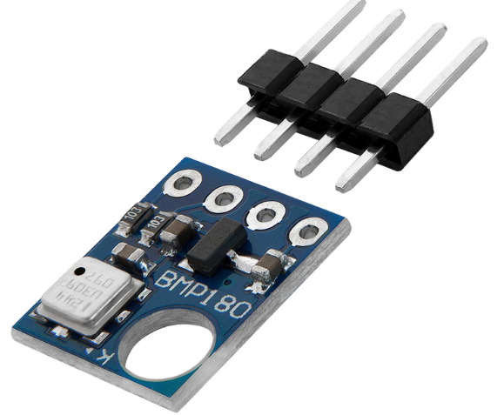
Robot Sensors
Environmental and Atmospheric Sensors
Temperature sensors: Measure ambient or component temperature; can also be used to monitor internal robot health.
Humidity sensors: Track moisture in the environment, useful in agricultural or weather-monitoring robots.
Gas sensors: Detect specific gases (e.g., CO₂, methane), often found in safety or inspection robots.
Barometric pressure sensors: Measure atmospheric pressure, used in altitude estimation (often in drones).

Slide 46
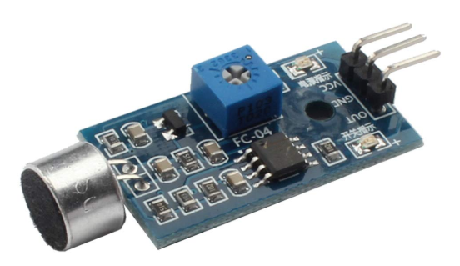
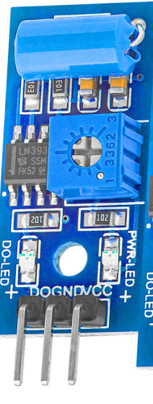
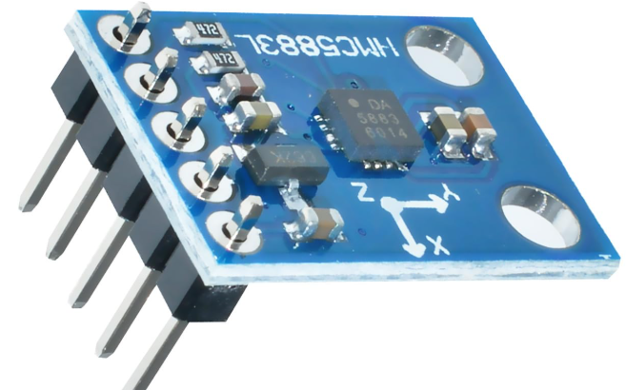
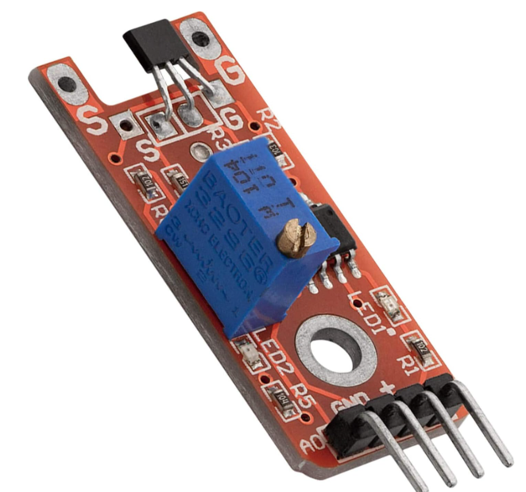
Robot Sensors
Sound and Vibration Sensors
Microphones: Allow robots to pick up auditory signals for speech recognition or sound localization.
Vibration sensors: Detect mechanical vibrations; can be used in predictive maintenance or for sensing specific mechanical resonances in industrial settings (5).
Magnetic and Electromagnetic Sensors
Magnetometers (compasses): Measure the strength and direction of magnetic fields for orientation or navigation (7).
Hall effect sensors: Measure magnetic field changes to detect the position of rotating shafts or wheels, often used in encoders or proximity detection (5).

Slide 47
Robotic Electric Actuators
DC Motors
Brushed DC motors: Operate by applying current to a rotating armature with a fixed stator. They are straightforward to control and commonly found in small robots, wheeled platforms, and servos.
Brushless DC motors (BLDC): Use electronic commutation instead of brushes, leading to higher efficiency, better performance, and reduced wear. They are popular in drones, robotic arms, and high-performance servos.
AC Motors
Induction motors: Widely used in industrial settings for high-power, continuous-operation tasks (e.g., conveyor belts, large robotic systems).
Synchronous motors: Useful in applications that require precise speed control.
Stepper Motors
Overview: Move in discrete steps, offering precise position control without the need for feedback (in open-loop setups).
Common Uses: 3D printers, CNC machines, and some robotic arms where accurate incremental motion is needed.
Servo Motors
Overview: Typically consist of a motor (DC or BLDC), a feedback sensor (e.g., potentiometer or encoder), and control circuitry in one package.
Why They’re Useful: Provide closed-loop position control, making them ideal for robotic joints, steering mechanisms, and precise positioning tasks.
Linear Electric Actuators
Overview: Convert rotary motion from a motor into linear motion, often through lead screws or belt drives.
Applications: Robot grippers, sliding doors in automated systems, and any linear motion (pushing/pulling) needs.

Slide 48
Robotic Pneumatic Actuators
Pneumatic Cylinders
How They Work: Use compressed air to produce linear or rotary motion.
Advantages: Lightweight, fast response, and relatively simple design.
Drawbacks: Require a continuous supply of compressed air, can be less precise than electric/hydraulic actuators.
Pneumatic Artificial Muscles (e.g., McKibben Muscles)
Overview: Flexible “muscles” made of a braided mesh and rubber bladder that contract when pressurized.
Applications: Soft robotics, prosthetics, and exoskeletons where compliance and safe human-robot interaction are crucial.

Slide 49
Robotic Hydraulic Actuators
Hydraulic Cylinders
How They Work: Use pressurized fluid to create linear or rotary motion.
Advantages: Very high power density, capable of lifting heavy loads.
Drawbacks: Complexity, potential leaks, and requirement for pumps and fluid reservoirs.
Hydraulic Motors
Overview: Convert hydraulic pressure into rotary motion.
Applications: Heavy-duty robots, construction machinery, or environments that demand large force output (e.g., deep-sea robotic arms).

Slide 50
Robotic Smart Material Actuators
Shape Memory Alloys (SMA)
How They Work: Metals (like Nitinol) that “remember” a shape. When heated, they return to a preset form, creating motion.
Applications: Small-scale robotics, medical devices, and niche applications needing quiet, compact actuation.
Piezoelectric Actuators
How They Work: Generate motion when an electric voltage is applied to piezoelectric crystals or ceramics.
Advantages: Extremely precise and fast response, often used in micro/nano positioning systems.
Drawbacks: Limited range of motion and can be expensive.
Electroactive Polymers (EAP)
Overview: Polymers that expand or contract under electrical stimulation, acting similarly to artificial muscles.
Applications: Soft robotics, haptic feedback devices, and biomimetic systems still in research or specialized niches.

Slide 51
Robotic Soft Actuators
Fluidic Elastomer Actuators
How They Work: Typically use pressurized air or fluid to inflate deformable elastomer chambers, causing them to bend or contract.
Advantages: Safe for human-robot interaction due to inherent compliance.
Applications: Wearable exoskeletons, soft grippers for handling delicate objects.
Tendon-Driven Systems
Overview: Use cables or tendons pulled by motors to achieve motion in soft or compliant robotic limbs.
Advantages: Lightweight, flexible designs.
Applications: Robotic hands, snake-like robots, and biomimetic structures.

Slide 52
Choosing the Right Actuators
Force or Torque Requirements:
Heavy-lifting or high-torque tasks may call for hydraulic or high-powered electric motors.
Speed and Precision:
Stepper motors and servo motors excel at precise positioning.
Piezo actuators and SMAs can be used for micro-scale or specialized tasks.
Weight and Size Constraints:
Pneumatics and soft actuators can be lightweight, but may lack fine control.
Electric servos are common for mid-range tasks where compactness is crucial.
Environmental Conditions:
Hydraulics and sealed electric motors handle harsh environments better,
but pneumatic or soft actuators may be safer around humans.
Cost and Complexity:
Electric actuators are often simpler to implement than hydraulics or pneumatics,
which require additional infrastructure (pumps, compressors, fluid reservoirs).

Slide 53
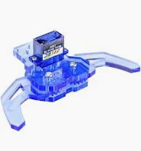
Types of grippers
Robot grippers (or end-effectors) are the “hands” of a robot,
enabling it to grasp, hold, and manipulate objects.
The choice of gripper depends on the task, the objects’ shape and material, and the required precision or force.
1. Parallel-Jaw (Two-Jaw) Grippers
Description: These have two opposing jaws that move in parallel to grip an object.
Common Uses: Pick-and-place applications in manufacturing or logistics, especially for objects with simple shapes (e.g., boxes, cylindrical parts).
Advantages: Simple design, relatively low cost, reliable.
Example: Schunk PGN series grippers.

Slide 54
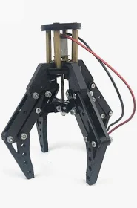
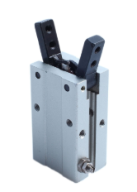
Types of grippers
2. Three-Jaw Grippers
Description: Similar to parallel-jaw grippers, but with three jaws equally spaced.
Common Uses: Centering or securely gripping round or cylindrical parts, often used in machining or assembly lines.
Advantages: More secure grip on circular objects, self-centering.
Example: Schunk ROTA or robotic 3-finger centric grippers.
3. Angular (Pivoting) Grippers
Description: The jaws pivot around a hinge rather than moving linearly.
Common Uses: Applications where the robot needs to approach from a specific angle or fit into tight spaces.
Advantages: Compact design, can handle a variety of part sizes.
Example: Robohand (DESTACO) angular grippers

Slide 55
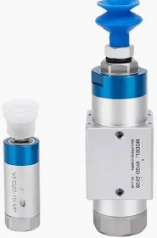
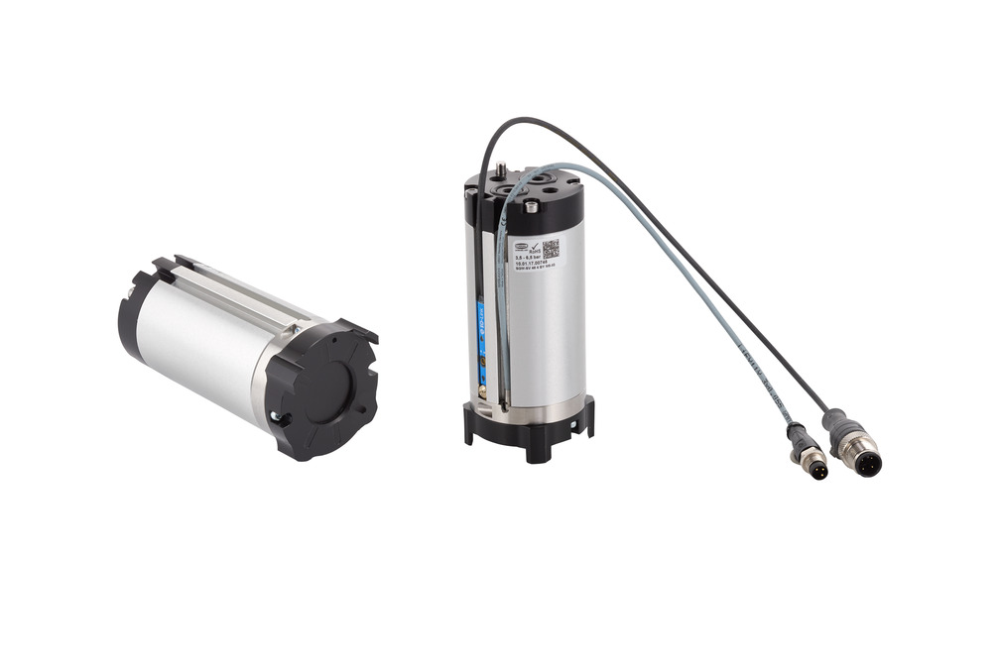
Types of grippers
4. Vacuum (Suction) Grippers
Description: Use suction cups or vacuum pads to pick up items by creating a pressure difference (vacuum).
Common Uses: Handling flat or slightly curved, smooth-surfaced objects (e.g., sheets of metal, glass, plastic packaging).
Commonly seen in pick-and-place on conveyor lines.
Advantages: Non-damaging to delicate objects (if the surface is airtight), fast gripping action.
Drawbacks: Require an external vacuum system; not suitable for very porous or irregular surfaces.
Example: Piab vacuum grippers, Festo suction cup arrays.
5. Magnetic Grippers
Description: Use permanent or electromagnets to hold ferromagnetic objects.
Common Uses: Handling metal parts, scrap metal, or steel sheets in factories.
Advantages: Simple and clean (no mechanical jaws or vacuum lines); quick pick-and-drop for magnetic parts.
Drawbacks: Only works with ferrous materials; electromagnets require power and can be large.
Example: SMC magnetic grippers, Schmalz permanent magnet end-effectors.

Slide 56
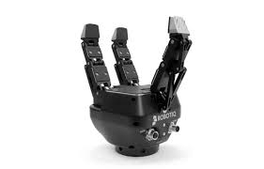
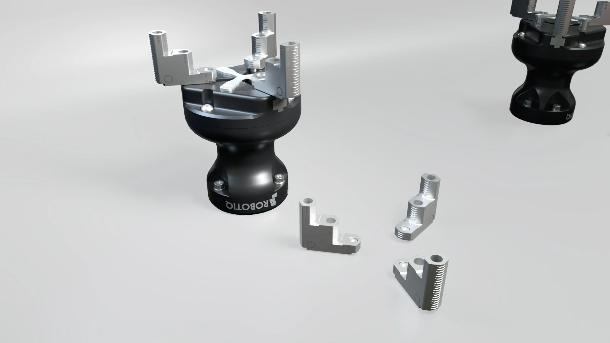
Types of grippers
6. Multi-Finger / Anthropomorphic Grippers
Description: Designed to mimic a human hand with multiple fingers and joints for more complex manipulation.
Common Uses: Research, service robots, or advanced industrial tasks requiring dexterous handling.
Advantages: High dexterity, can handle a wide range of shapes/sizes.
Drawbacks: More complex control and higher cost.
Example: BarrettHand, Shadow Dexterous Hand, Robotiq 3-Finger Adaptive Gripper.
7. Soft / Adaptive Grippers
Description: Made from flexible materials (silicone, rubber) or use mechanical linkages that passively adapt to an object’s contours.
Common Uses: Handling delicate or irregularly shaped objects such as produce, fragile goods, or mixed items in food processing and e-commerce fulfillment.
Advantages: Safe for delicate items, robust against shape variations, good for collaborative robots around humans.
Examples: Soft Robotics Inc. grippers, Robotiq 2F Adaptive Grippers.

Slide 57
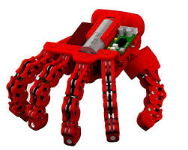
Types of grippers
8. Underactuated / Compliant Grippers
Description: Grippers that rely on mechanical compliance or fewer actuators than degrees of freedom, allowing the fingers to conform to an object’s shape.
Common Uses: Scenarios where objects vary in size or shape, and a single gripper design must work for many different items.
Advantages: Fewer motors needed, can be lighter, cheaper, and still handle varied shapes.
Drawbacks: Less precise control of individual fingers.
Example: Pisa/IIT SoftHand, RightHand Robotics’ underactuated fingers.
9. Needle Grippers
Description: Use a set of retractable needles to impale or pierce soft or bag-like materials for picking.
Common Uses: Handling textiles, foam, or bags that are hard to grab with suction or jaws.
Advantages: Can handle loosely packaged, porous, or soft objects where suction or conventional gripping is difficult.
Drawbacks: May damage the material or cause holes; limited to flexible items.
Example: Custom-designed needle grippers in automated packaging lines.

Slide 58
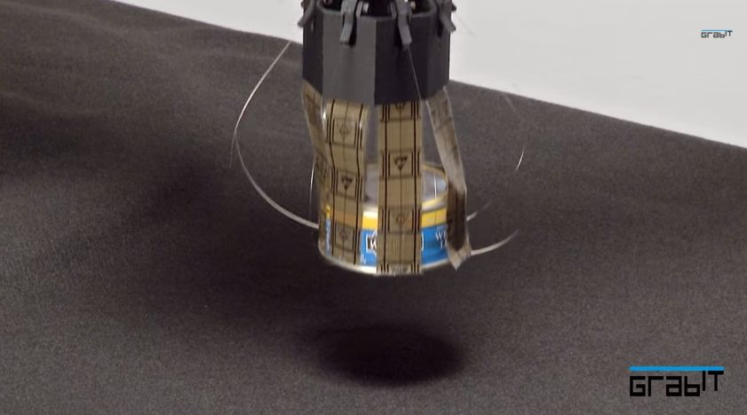
Types of grippers
10. Electroadhesive GrippersDescription:
Create electrostatic forces that “stick” to surfaces, similar to static cling.
Common Uses: Handling lightweight objects like paper, fabric,
Advantages: Low energy consumption, can grip a variety of surfaces
Drawbacks: dust or moisture, typically limited to low-weight objects.
Example: Grabit’s electroadhesive gripping solutions.
Key Considerations When Choosing a Gripper
Object Properties: Size, shape, weight, material (porous or non-porous, ferrous or non-ferrous, rigid or soft).
Required Grip Force: How securely you need to hold the object, and whether the gripper can apply gentle or high force.
Speed and Cycle Time: Production requirements might dictate how quickly a gripper must move and release objects.
Environment: Cleanliness (e.g., food-grade, medical), presence of contaminants (dust, moisture), or temperature extremes.
Robot Type and Payload: Collaborative or industrial robot, maximum payload, reach, and dexterity needed.

Slide 59
1. Introduction
https://www.roboticsbook.org/S10_introduction.html
E.g., place the chairs in the room into a circular pattern,
Sense-Think-Act paradigm
Robotic systems:
Sensing: computer vision, touch sensors, laser range scanners etc.
Thinking: reasoning about which actions the robot could perform
acting : robot moves in, and interacts with, its environment.
These steps are typically performed iteratively.
sense-think-act loop.
Speed
Chess playing robot, a single iteration could take seconds or minutes
self-driving car, a single iteration might take milliseconds

Slide 60
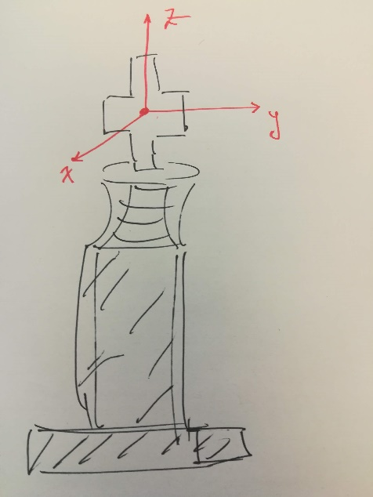
1.1 Representing State
information necessary to understand the environment well enough
Eg. Robot house keper
Moving from the bedroom to the laundry room: high-level description of the layout of rooms, household object locations,
Folding the laundry: model articles of clothing as nonrigid, deformable objects.
Chess playing robot:
complete list of the positions of all chess pieces on the board.
if task requires manipulating objects in the environment, a more precise geometric description of the state may be required
The frame origin is located at the center of the cross. The frame is rigidly attached to the chess piece, and moves when the piece moves.

Slide 61
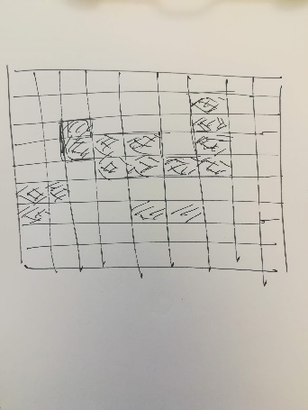
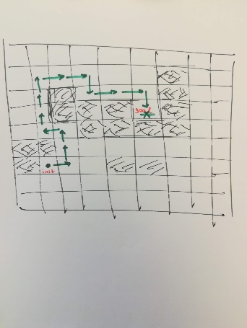
E.g., in table tennis estimate not only the position of the ball, but also the trajectory of the ball,
It is often the case that discrete time representations are preferable to using continuous time.
Usually robot does not have access to a complete and correct model of its environment.
tools from probability theory
Obstacles

Slide 62
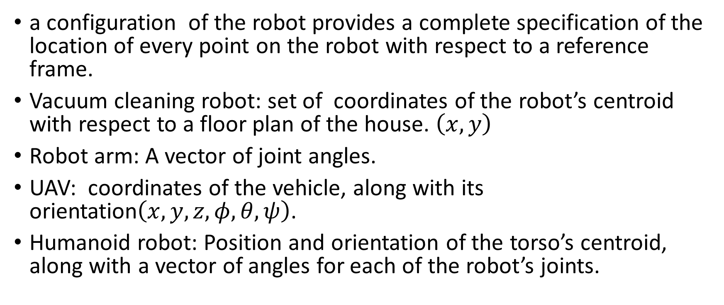
1.1.2 Representing Robot’s State
a configuration of the robot provides a complete specification of the location of every point on the robot with respect to a reference frame.
Vacuum cleaning robot: set of coordinates of the robot’s centroid with respect to a floor plan of the house. $\left(x,y\right)$
Robot arm: A vector of joint angles.
UAV: coordinates of the vehicle, along with its orientation$\left(x,y,z,φ,θ,ψ\right)$.
Humanoid robot: Position and orientation of the torso’s centroid, along with a vector of angles for each of the robot’s joints.

Slide 63
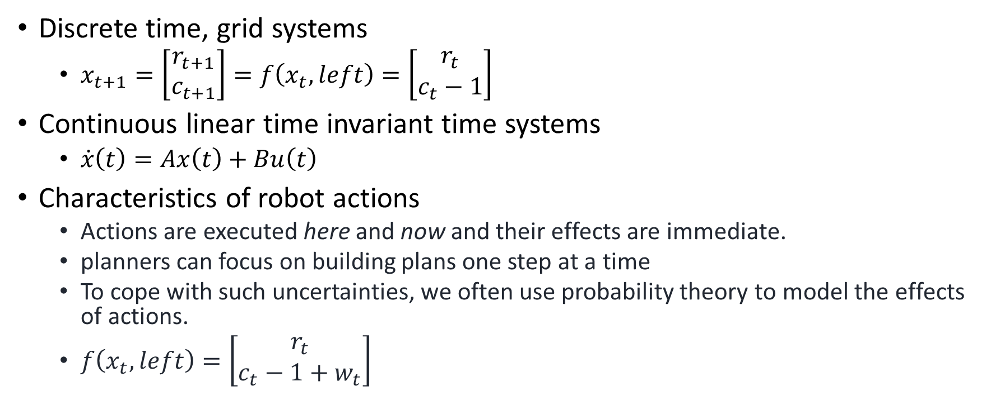
1.2 Robot Actions
Discrete time, grid systems
$x_{t+1}=\left[\begin{matrix}r_{t+1} \\ c_{t+1}\end{matrix}\right]=f\left(x_{t},left\right)=\left[\begin{matrix}r_{t} \\ c_{t}−1\end{matrix}\right]$
Continuous linear time invariant time systems
$\dot{x}\left(t\right)=Ax\left(t\right)+Bu\left(t\right)$
Characteristics of robot actions
Actions are executed here and now and their effects are immediate.
planners can focus on building plans one step at a time
To cope with such uncertainties, we often use probability theory to model the effects of actions.
$f\left(x_{t},left\right)=\left[\begin{matrix}r_{t} \\ c_{t}−1+w_{t}\end{matrix}\right]$

Slide 64
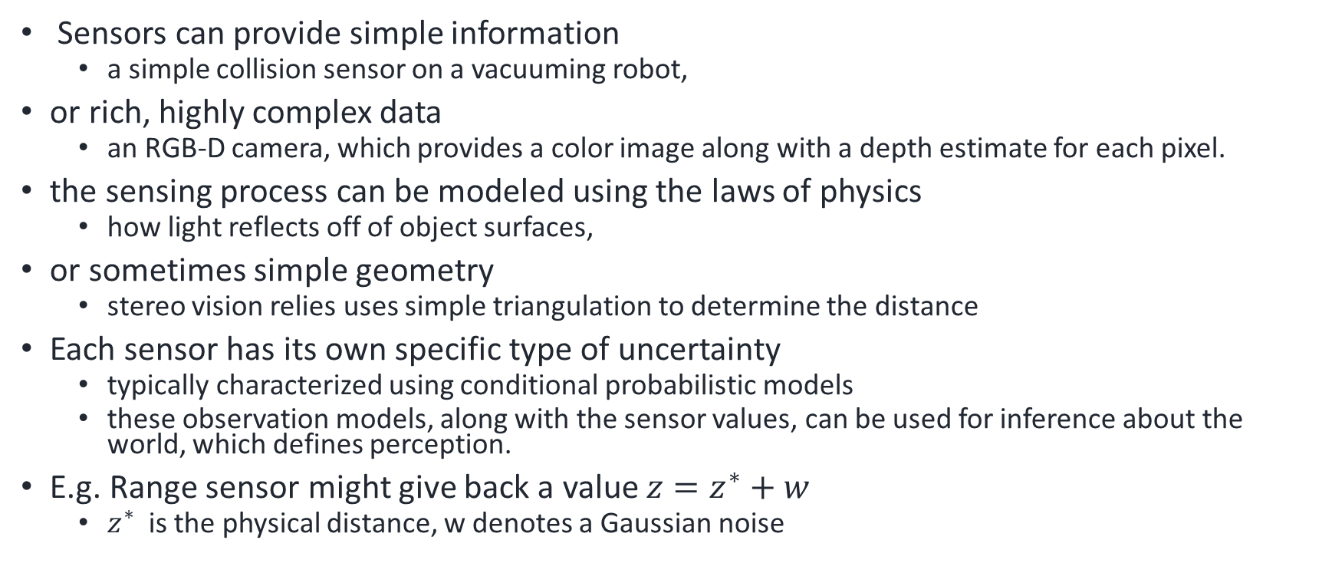
1.3 Sensing
Sensors can provide simple information
a simple collision sensor on a vacuuming robot,
or rich, highly complex data
an RGB-D camera, which provides a color image along with a depth estimate for each pixel.
the sensing process can be modeled using the laws of physics
how light reflects off of object surfaces,
or sometimes simple geometry
stereo vision relies uses simple triangulation to determine the distance
Each sensor has its own specific type of uncertainty
typically characterized using conditional probabilistic models
these observation models, along with the sensor values, can be used for inference about the world, which defines perception.
E.g. Range sensor might give back a value $z=z^{∗}+w$
$z^{∗}$ is the physical distance, w denotes a Gaussian noise

Slide 65
1.4 Perception
Forward model: map state to sensor values (physics)
Inverse problem: Perception, given sensor values, infer about the state
Notoriously difficult and ill defined problem (uncertainty)
Distance 10 meters → sensor reading z=10
Sensor reading z=10 → Distance
many possible states that could lead to a z=10
Perhaps another robot has crossed 10 meters in front of the sensor
Perhaps an open door 10 meters in front of the robot has just been closed.
Perception is concerned with these inverse problems.

Slide 66
1.5 Planning
Task Planning
High level of abstraction,
ignoring details geometry of the environment, path traversed, and dynamics
Actions described in symbolic terms, e.g. «Move», «go»
consider costs associated to each action , and probabilities
Not consider e.g. how to grasp the item or motor torques
Useful when basic skills (primitives) exist, or when task planner is integrated into an overall system
Path Planning
Moving the robot from one position to another (sequence of free grid cells from initial to goal).
Avoiding collisions with obstacles in the environment
Discretize the world into a grids (free or obstacle): very conservative and may make problem infeasible
Computational complexity exponential with the number of degrees of freedom
computationally efficient algorithms that perform well in practice,
Trajectory Planning
Path planning: “shape” of the
trajectory planning: also how fast the car traverses the road (Dynamics, aerodynamics (for drones))
Dealing with Uncertainty
Sometimes uncertainties cannot be neglected (then model it)
choose actions that minimize the average cost over long time horizons. (vacuuming robot vs self driving car)
Uncertainty in sensing
Uncertainty in actions - Markov Decision Processes

Slide 67
1.6 Learning
Impossible to program a robot for all situations that might occur.
Usually things are simply too complex to model exactly.
E.g. bipedal robot walking over uneven terrain
Machine learning approaches can be used
adapt to unknown or changing circumstances,
or to improve the robot’s performance over time.
Reinforcement Learning (RL)
Make an action, obtain reward or punishment, then update your Q matrix which maps action rewards to each state
Suitable for discrete state and action space
Deep Learning
Used to single shot problems to train the robot based on labeled data
Deep Reinforcement Learning (Deep RL)
.Utilizes a neural network instead of a Q matrix
Suitable for both discrete and continuous state and action spaces.

Slide 68
2. A Trash Sorting Robot
Robot is presented with items of trash, one at a time, on a conveyor belt.
Category of the item (state), e.g., paper, metal, etc.,
move the item (actions) into the appropriate bin.
Sensors are used to measure characteristics (sensing) of a given item of trash,
measurements are then used to infer the item’s category (simple perception).
Then the robot chooses an action (planning) to place the item in an appropriate bin.
The robot can refine its model of the world based on data acquired during operation (learning), and this new model can be used to improve operation over time.
Simplified model: no geometric or physical aspects of robot motion,
Robot can move items without error.
Uncertainty associated to the problem of classifying items of trash

Slide 69


2.1, 2.2 Modeling the State and Action
States= {cardboard, paper, cans, scrap metal, bottle}
Probability of occurence={0.2,0.3,0.25,0.20,0.05}
Actions
$a_{1}$: put in glass bin
$a_{2}$: put in metal bin
$a_{3}$: put in mixed paper bin
$a_{4}$: let the object continue
Cost : for each (state, action) pair

Slide 70

2.3 Sensors and Decision
a conductivity sensor, outputting the value True or False
a camera with a three detection algorithms: bottle, cardboard, paper
a scale, which gives a continuous value in kg.
Maximum Likelihood
Maximum likelihood estimation outputs the state that “agrees” most with the measurement.
No sensor available: Naive decision using priors(paper bin)
Worst case optimization: minimize the damage that can occur in the worst case scenario. (nop action)
Incorportating sensor information
$\arg{\min_{a}{E\left[cost\left(a,C\right)|S=s\right]}}=\arg{\min_{a}{\sum_{c∈Ω}{cost\left(a,c\right)P(c|S=s)}}}$

Slide 71
3 Robot Vacuum Cleaner
Robot can perform navigation, motion planning, and motion control.
We focus on high-level problems (e.g. which room to clean next), without worrying about low-level details
Differences:
effects of actions depend on the current world state;
if a robot is in the living room and moves to its left, it will arrive to a different location than if it had started in the office.
Second, the actions executed by the vacuum cleaning robot have future (and uncertain) effects
achieving goals in the future will depend on the actions the robot executes now
states correspond to rooms in the house,
trajectories correspond to the robot moving from room to room.
Sensing is quite limited in this chapter.
simple (discrete) light sensor.
perception becomes a more interesting problem.
Hidden Markov Models (HMMs), which define probabilistic models for sensing over time.
Planning: sequences of actions that occur over time.
Markov Decision Processes (MDPs).
the notion of reward,
deduce an optimal policy, i.e., what to do in each state to maximize the aggregate reward over time.
reinforcement learning: where we will estimate the parameters of an MDP using data that is obtained during the robot’s normal operation.

Slide 72

3.1 Modeling States
Location: Exact (x,y) or just the room
Heading: May be neglected
Physical condition : e.g. Floor carpeted or not
Location of any pets or children: Robot may have collision avoidance software
Time: Discrete t={1,2,3,…}
States: X_1, X_2,…
Initially : Random quantity with a prior distribution
Transitions: May be limited

Slide 73
4. Warehouse Robots
Robot that operates in a warehouse, main task is to transport products from various storage locations to a shipping station.
Much more clomplex but realistic model
state space is continuous.
Uncertaintly: Gaussian distribution.
one-dimensional distributions for a range sensor,
two-dimensional distributions for a GPS-like sensor.
determine the robot’s current location (i.e., the current state).
Hidden markov Models
Particle filter
Kalman filter

Slide 74
5. A Mobile Robot With Simple Kinematics
A simple, differential-drive robot that is similar to a car, but can rotate in place.
Robot with differential drive, i.e, two wheels that can spin in either direction to move the robot
sensor: the camera.
deep neural networks in computer vision.
multilayer perceptrons and convolutional neural networks
State: vehicle position , but also vehicle orientation
Actuators: differential drive to control orientation.
Sensors: camera, image formation, image processing concepts.
Perception: multi-layer perceptrons (MLPs) convolutional neural networks
Planning: potential fields but also sampling-based planning methods for differential drive vehicles.
Learning: stochastic gradient descent to learn parameters of neural networks.

Slide 75


5.1 States
Location: X,y coordinated of center of mass
Orientation: attach a coordinate frame to the robot,
robot state: origin of this frame and the orientation of the frame with repsect to the world frame
Motion model

Slide 76


5.3 Robot Vision
Cameras
Images
multi-dimensional arrays (R, G,B)
$H×W×3$ pixels
Changing to grayscale
Linear filtering : performing linear operations on pixels
Edge detection: finding transitions between dark and light areas
A filter of size 3: [-1 0 1]
Convolution with this filter
This filter is shifted through the pixel array

Slide 77


5.4 Computer Vision
Convolution is in fact correlation
Convolution can be extended to 2D
A 2D filter array is shifted through a pixel array
This is in fact a gradient operator
Edges have higher magnitüde
We pass this output from a threshold operator to find the edges

Slide 78

5.4 Computer Vision
In convolution we engineer the feature ourselves
Feature engineering requires expert knowledge
Perceptron
$f\left(x\right)=θ\left(\sum_{i}{w\left[i\right]x\left[i\right]+b}\right)$
$θ:$ e.g. Sigmoid function
Then a thresholding operation
Multilayer perceptron
Going wide (multiple outputs)
Going deep (multiple layers)
Deep neural networks don’t need feature engineering
Convolutional Neural Networks:
Involve convolution layers
Pooling: Perform averaging in order to reduce the size
LeNet neural network achieves almost 100% rate in handwritten digit classification for the MNIST database.

Slide 79
5.6 Deep Learning
Supervised Learning
Training dataset: Labeled
Classification : labels are discrete
Regression: Labels are continuous
Interpolation
Loss function: Measure of difference of predicted value from the real value (label)
Mean square loss
Cross entropy
Weights are updated at each iteration in order to minimize the loss
Gradient descent
Stochastic gradient descent (faster)
Test dataset (to validate)

Slide 80

6 Sensing for Autonomous Vehicles
Light Radar (LIDAR), a sensor found in most autonomous cars,
constructs a 3D representation of the robot’s environment in real time.
measures distance by using laser light and “Time of Flight” or ToF
$Δt=\frac{2d}{c}, d=\frac{cΔt}{2}$
light is emitted with a waveform, e.g., a sine wave,
and the returned light is correlated with the amplitude of the emitted light to calculate a phase-shift.
2D LIDAR, consists of a single laser beam that is rotated around a fixed axis,
3D LIDAR, multiple laser/detector pairs rotated at different inclinations.

Slide 81

6.4 SLAM
Simultaneous localization and mapping
A chicken and egg problem
If we have a map, we can use localization techniques
If localized then it is easy to map
Point clouds obtained from depth sensors (like LiDAR) are commonly used with ICP for tasks such as mapping or object recognition.
Iterative closest point (ICP)
aligning two sets of 3D point clouds or 2D shapes.
find the transformation (translation and rotation) that best aligns one set of points with another.
Initialization: Start with an initial estimate of the transformation (translation and rotation).
Correspondence: associating each point in one set with its nearest neighbor in the other set.
Alignment: Use the correspondences to refine the transformation parameters.
Iterate: Repeat the correspondence and alignment steps iteratively until convergence
SLAM with Landmarks
The system uses sensors, such as cameras or lidar, to observe the environment.
Landmarks are distinctive features in the environment, like corners of buildings, specific objects, or any other recognizable points.
As the system moves, it identifies and marks these landmarks in its observations

Slide 82
7. Autonomous Drones
Inertial measurement units
measure how a rigid body moves through space,
three sensors: gyroscopes, accelerometers, and magnetometers,
Gyroscopes
measures changes in orientation around three orthogonal axes,
Error due to noise is also integrated over time.
Accelerometer
Measures linear acceleration
Doubly integrate to measure change in position
Fuse with a gyroscope
Magnetometers
measures a 3D vector that points along Earth’s local magnetic field (noisy)
Cameras
Visual odometry (with preexisting map), Visual SLAM (without map)

Slide 83
Classroom Exercise!!
Look online for videos of robots
Select one that you find interesting
Try to list the robot sensors and actuators
Share and discuss your videos and ideas in groups

Slide 84
Some Videos
https://www.youtube.com/watch?v=f7hu67Bk5bA&ab_channel=CatersClips
https://www.youtube.com/watch?v=P4boyXQuUIw&ab_channel=NASAJetPropulsionLaboratory
https://www.youtube.com/watch?v=hA_-MkU0Nfw&t=89s&ab_channel=Waymo
https://www.youtube.com/watch?v=wM6RogoMs_I&ab_channel=RobotLABInc.
https://www.youtube.com/watch?v=peaKnkNX4vc&ab_channel=amazon
https://www.youtube.com/watch?v=IMPbKVb8y8s&t=1s&ab_channel=TechVision

Slide 85
Your robot videos
Think about their control strategies and architecture
Focus on autonomy: Do they plan? Adapt? Learn?
Illustrate your examples briefly to the class

Slide 86
Overview of the lecture:
Python introduction
Lists
Tuples
Dictionaries
Object oriented programming

Slide 87
Programming Languages
Compilers/Interpreters
Unstructured/Structured
Structured programming languages: top-down design with a more organised and systematic approach to programming for example using subroutines and block structures. E.g C, Java, Python
Unstructured programming languages: no specific rules/structures, simpler and just a series of commands and statement. E.g Assembly, earlier version of BASIC
Object Oriented

Slide 88
Python
Object oriented (loosely)
Structured (fairly)
Interpreter
Quick learning curve

Slide 89
Setup for the course
Download and Install Anaconda
Create a virtual environment (different files depending on your OS)
Open JupyterLab
Work with both notebooks and .py scripts with JupyterLab
https://www.anaconda.com/download/

Slide 90

Choose your operating system

Slide 91

Choose you operating system

Slide 92
Remove any spaces in the username
Add Anaconda to my Path environment variable
After installation we now need to download the libraries used for this course.
The installation has installed the Anaconda Prompt command line tool.
We’ll be using it for these next step
Create a new environment
Install JupyterLab, Jupyter Notebook and VSCode in this environment

Slide 93
Numpy Arrays
Open 00-NumPy-Arrays
Run the line by shift-enter
Arrays
Numpy:
List
Np.array
Np.arange
Np.zeros, np.ones
Operations
Np.random.randint
We can use the following on numpy arrays
Max, min, mean, argmin, argmax, reshape
Np.arange.reshape

Slide 94
Images and Numpy
from PIL import Image
import matplotlib.pyplot as plt
Image.open
np.asarray(pic)
pic_arr.shape: (1300,1950,3) shape
plt.imshow(pic_arr)
pic_red = pic_arr.copy(), pic_red[:, :, 1] = 0 , pic_red[:, :, 2] = 0

Slide 95
OpenCV
Open Anaconda Prompt
Type (or paste):
conda install opencv
pip install opencv-python
This should install OpenCV 4 (.7 latest stable version)

Slide 96
Some resources
On-line Computer Vision Compendium (University of Edinburgh):
http://homepages.inf.ed.ac.uk/rbf/CVonline/
Comprehensive list of computer vision methods:
https://sites.google.com/site/cvonlinewiki/home/generic-computer-vision-methods
OpenCV tutorials:
https://docs.opencv.org/4.5.0/d9/df8/tutorial_root.html
Image processing in OpenCV (but not only):
https://docs.opencv.org/4.5.0/d2/d96/tutorial_py_table_of_contents_imgproc.html
In OpenCV, make sure you are looking at the Python code, not C++

Slide 97
Lists
Basic Operations
Python Expression | Results | Description
len([1, 2, 3]) | 3 | Length
[1, 2, 3] + [4, 5, 6] | [1, 2, 3, 4, 5, 6] | Concatenation
[3] * 4 | [3, 3, 3, 3] | Repetition
3 in [1, 2, 3] | True | Membership
min([1,2,3]) | 1 | Minimum
max([1,2,3]) | 3 | Maximum

Slide 98
Lists
Indexing and slicing;
L = [1, 2, 3]
Python Expression | Results | Description
L[2] | 3 | List starts at zero
L[-2] | 2 | Negative: count from the right (last element = -1)
L[1] = 4 | [1, 4, 3] | Change an element
L[1:] | [2, 3] | Slicing remainder of list, including indexed element
L[:-1] | [1, 2] | Slicing start of list, excluding indexed element
L[1:-1] | [2] | Slicing section of list

Slide 99
Lists
Manipulations
L = [1, 2, 3]
Python Expression | Results | Description
L.append(4) | [1, 2, 3, 4] | Append element
L.count(3) | 1 | Count element
L.extend([4, 5]) | [1, 2, 3, 4, 5] | Append each element of the new list append([4,5])
L.index(3) | 2 | Index of 1st occurrence
L.insert(1,4) | [1, 4, 2, 3] | Insert element at index
L.remove(2) | [1, 3] | Remove element (1st)
L.pop(2) | [1, 2] | Delete and return element by index

Slide 100
Tuples
T = (1, 2, 3, ‘a’, ‘b’)
They are sorted sequences. As a list but with () …
Tuple elements can be indexed exactly as list elements, but tuples are immutable: they cannot be changed once defined.
Convenient when you have a fixed-length sequence of elements that will never change (e.g. an offset for a coordinate transformation).
If you want a list: L = list(T)

Slide 101
Dictionaries
d = {}
d = {‘a’:2, ‘b’:’zzz’, 1:3, 2:’zzz’}
Unsorted and named collection of elements.
Dictionaries have keys and values; keys are always unique.
Dictionaries are accessed by keys: d[‘a’]
Very convenient for structured data, where you naturally have keys and values, e.g. names, codes, identifiers, symbols, abbreviations

Slide 102
Dictionaries
>>> d = {’Aron’:’M00549990’, ‘Federico’:’M00500389’, ‘Chibuike’:’M00543047’}
>>> print d[‘Aron’]
’M00549990’
>>> d[‘Tommy’] = ’M00523470’
>>> print d[‘Tommy’]
’M00523470’
>>> d[‘Federico’]=’M00551760’
>>> del d[‘Chibuike’]
>>> print d
{’Aron’:’M00549990’, ‘Federico’:’M00500389’, ‘Tommy’:’M00523470’}

Slide 103
Object Oriented Python
class Circle():
def __init__(self, r): # compulsory object constructor, run each time an object of type Circle is created
self.radius = r # self indicates the object itself, radius is a property of class Circle
def area(self): # method of class Circle
return self.radius**2*3.14
def perimeter(self):
return 2*self.radius*3.14
NewCircle = Circle(8) # NewCircle is created as object (=instance) of class Circle
print NewCircle.area() # access methods - note () for empty parameter list
print NewCircle.perimeter()
Within a class: Variables => properties
Functions => methods

Slide 104
Important libraries
import numpy
import matplotlib
import scipy [.stats]
import math
import sys
import string
import datetime
Import cv2
Import sklearn
Import keras
Import tensorflow
Import torchvision

